Slide 1
Lecture 5
Chapter 18: Sections 18.3-18.5
Electric Potential

Slide 2



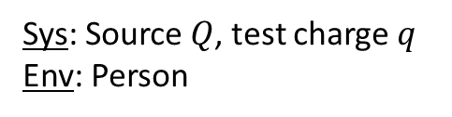



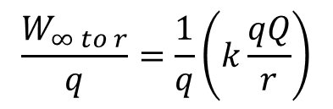


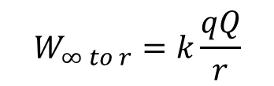




The potential energy of a system (source and test charge) changes when work is done to move the test charge in the source’s field.
Sys: Source $Q$, test charge $q$ Env: Person
External force overcome internal repulsion
$${\vec{F}}_{P on q}$$
$$q$$
$$W=∆U_{q}$$
$$Q$$
$$+$$
$$+$$
$$=U_{q,f}−U_{q,i}$$
$$r$$
Moving a charge from infinity
Work done per unit of charge
$$W_{∞ to r}=U_{q,f}−U_{q,i}$$
$$\frac{W_{∞ to r}}{q}=\frac{1}{q}\left(k\frac{qQ}{r}\right)$$
$=0$ at $∞$
$$W_{∞ to r}=k\frac{qQ}{r}$$
Electric potential
Created by Q
$$V=k\frac{Q}{r}$$
Depends
only on source

Slide 3




















The electric potential measures the work done per unit charge when moving a test charge from infinity to a location in the field of a source. The electric potential is a scalar field.
Scalar field
electric potential has
a value at every position
Electric potential
Created by Q
$$V_{3}$$
$$V=k\frac{Q}{r}$$
$$×$$
$$V_{2}$$
$$r_{3}$$
$$r_{2}$$
$$×$$
Potential difference
between positions
Units: Volt $V=\frac{J}{C}$
$$Q$$
$$r_{1}$$
$$×$$
$$V_{1}$$
$$∆V=V_{2}−V_{1}$$
Electric potential vs. Electric potential energy
Final position: 2
$$q$$
$$×$$
$$V_{2}$$
$$∆V=V_{2}−V_{1}$$
$$Q$$
$$×$$
$$V_{1}$$
Initial position: 1

Slide 4






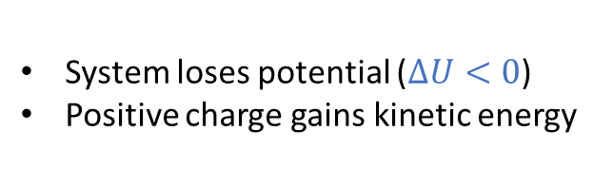

















1. The change in the electric potential is path independent.
2. The electric field points in the direction in which the electric potential decreases most rapidly.
1.
$$\vec{E}$$
$∆V$is path independent
2.
$$V_{A}$$
$$×$$
$$A$$
$$×$$
$$V_{B}$$
$$B$$
1
2
3
Motion and electric potential: A positive charge q moves from A to B
System: Charge, Plates
Surroundings: None
$$−$$
$$−$$
$$−$$
$$−$$
$$−$$
$$−$$
$$V_{B}−V_{A}<0$$
$$×$$
$$∆U=q∆V$$
$$∆U<0$$
$$q>0$$
$$V_{B}$$
Low potential
System loses potential ($∆U<0$)
Positive charge gains kinetic energy
$$×$$
$$V_{A}$$
High potential
$$+$$
$$+$$
$$+$$
$$+$$
$$+$$
$$+$$

Slide 5
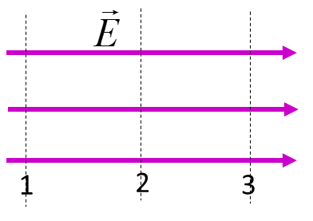
Positive charges move in the direction in which V decreases
Negative charges move in the direction in which V increases
+
-

Slide 6
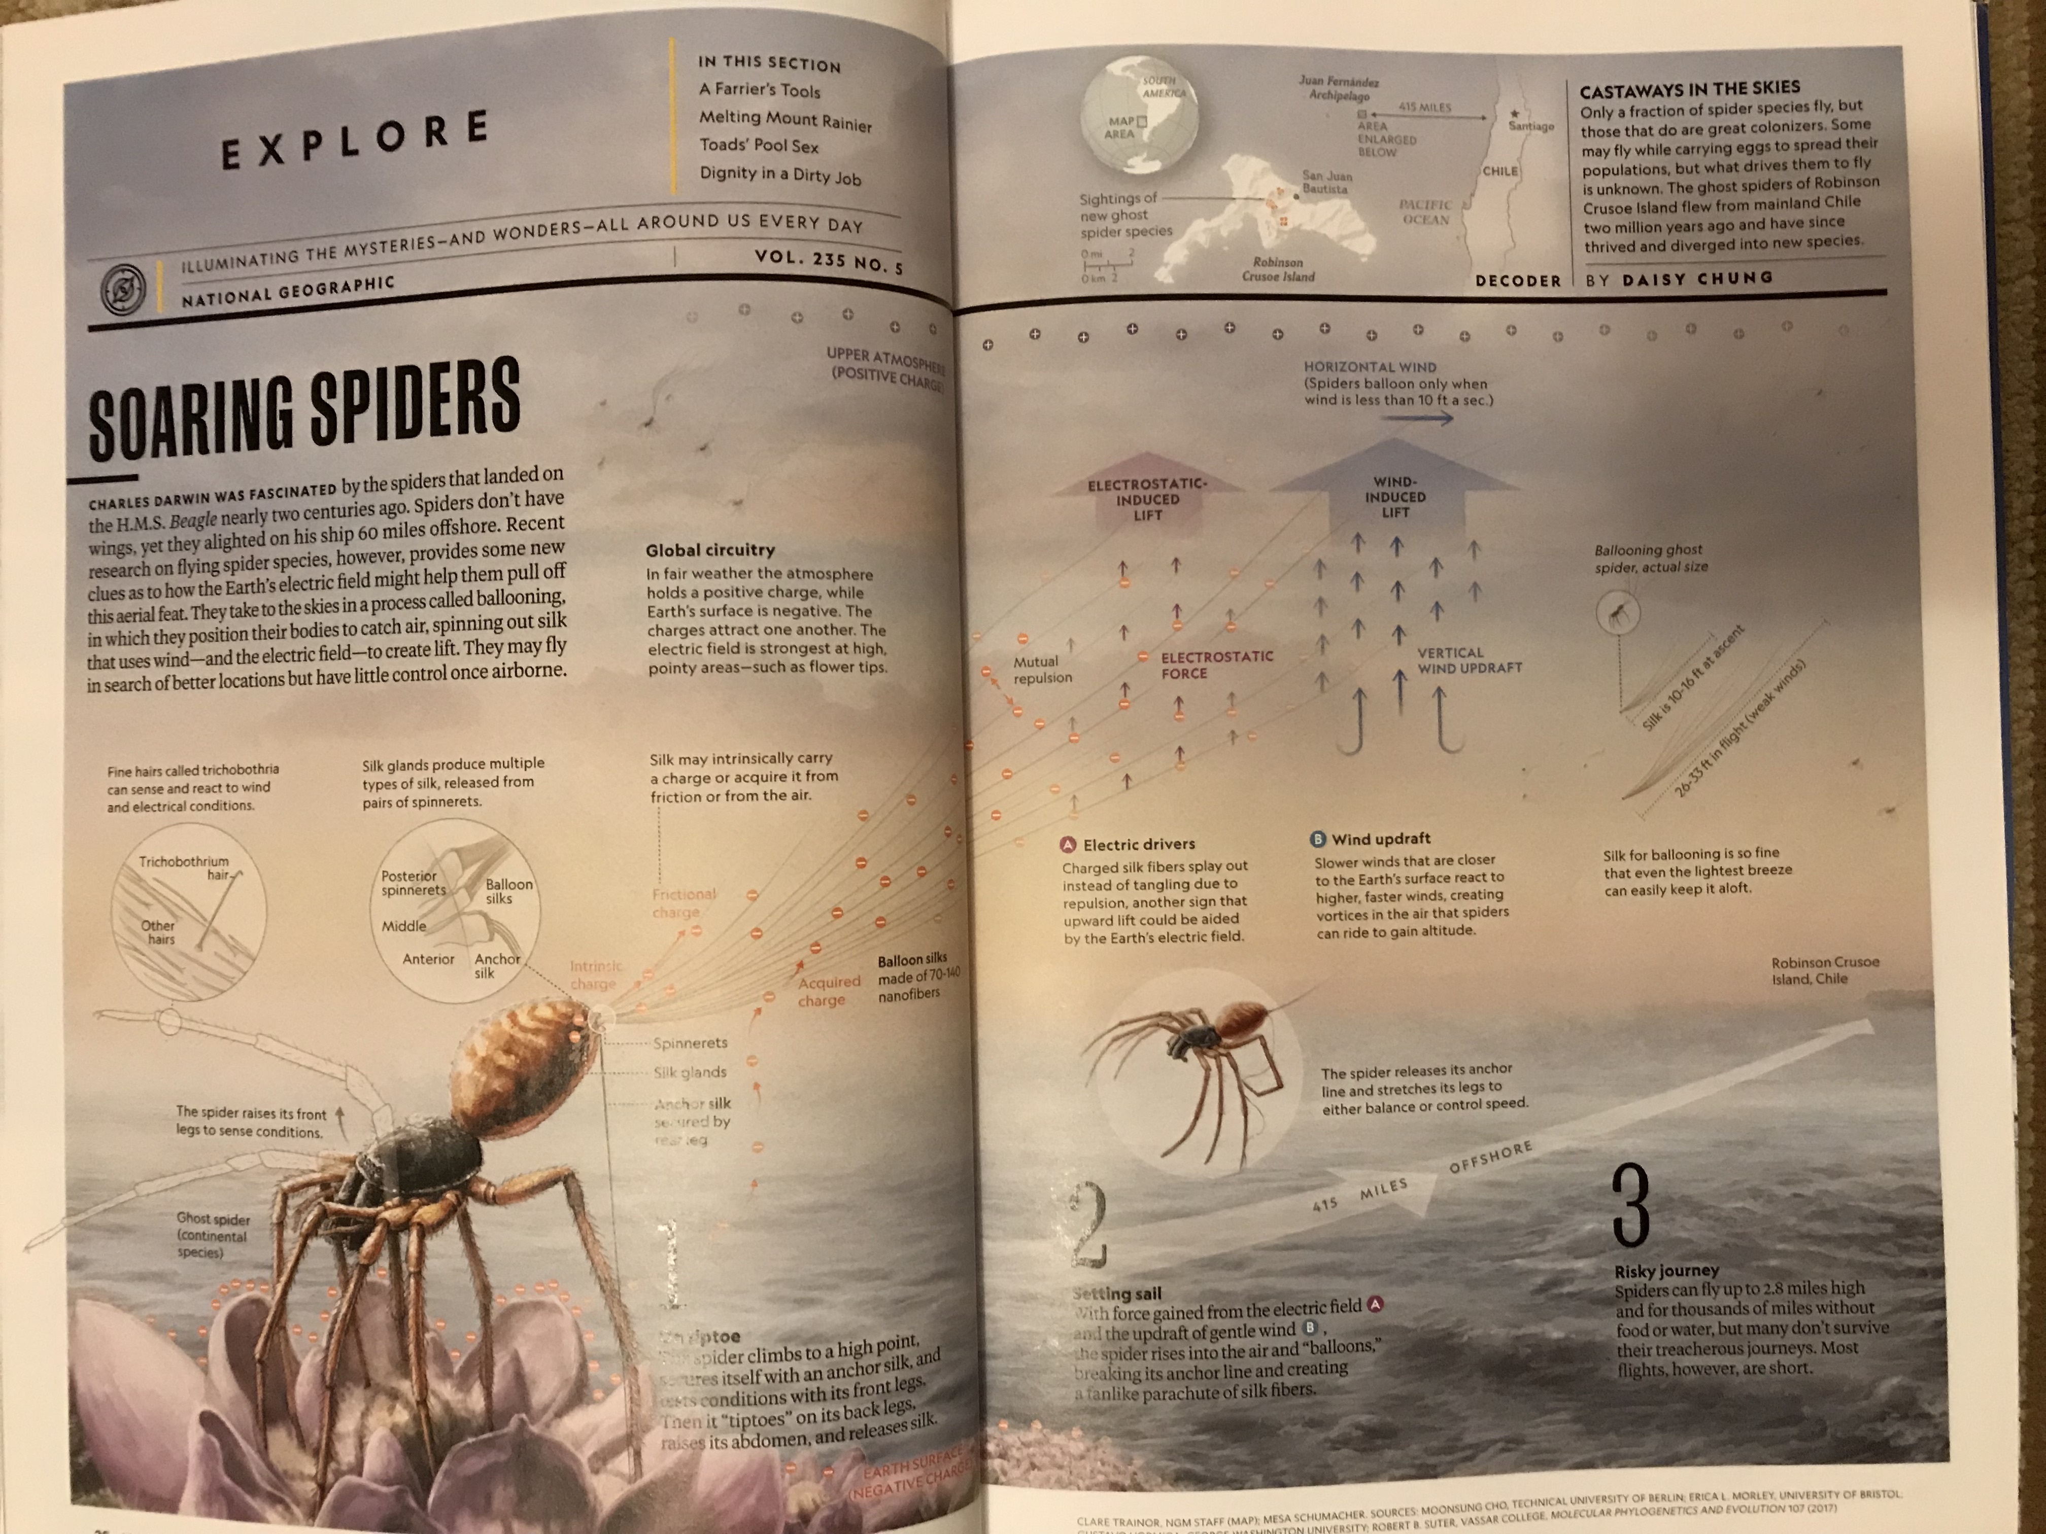

Example:
$$\overset{⃑}{E}$$

Slide 7






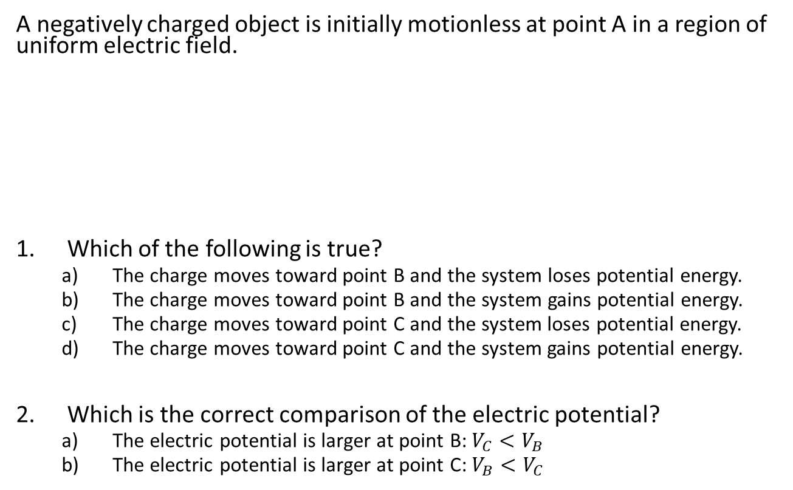










Concept Check:
Potential energy, charge, and potential difference
A negatively charged object is initially motionless at point A in a region of uniform electric field.
Which of the following is true?
  The charge moves toward point B and the system loses potential energy.
  The charge moves toward point B and the system gains potential energy.
  The charge moves toward point C and the system loses potential energy.
  The charge moves toward point C and the system gains potential energy.
Which is the correct comparison of the electric potential?
  The electric potential is larger at point B: $V_{C}<V_{B}$
  The electric potential is larger at point C: $V_{B}<V_{C}$
$$−$$
$$−$$
$$−$$
$$−$$
Sys: Charge, Plates
Sur: None
$$×$$
$$B$$
Low potential
$$A$$
-
$$q<0$$
$$×$$
$$C$$
$$+$$
$$+$$
$$+$$
$$+$$
High potential
$$q<0$$
$$∆U=q∆V$$
$$∆U<0$$
$$V_{C}−V_{A}>0$$

Slide 8





















Example 1: Apply the work-energy equation to find changes of energy when an electric potential difference is known.
An electron travels between two equally but oppositely charged plates in a uniform field. It starts from rest at the negative plate. How much kinetic energy does it gain if there is a 20V difference between the plates?
Gather:
Solve:
$$q_{e}=−e$$
$$=−1.60×{10}^{−19}C$$
$$−$$
$$−$$
$$−$$
$$−$$
Low potential
System: Charge, Plates
Surrounding: None
$$×$$
$$A$$
$$E_{sys}=K+U_{q}$$
$$∆V=V_{B}−V_{A}$$
$$=+20V$$
$$B$$
-
High potential
$$+$$
$$+$$
$$+$$
$$+$$
Apply the work-energy equation
$$∆K=−∆U$$
Units:
$C∙V=C∙\frac{J}{C}$
$$K_{f}−K_{i}=−\left(q∆V\right)$$
Electron-Volt eV (unit of energy)
$$K_{f}=−\left(−1.60×{10}^{−19}C\right)\left(+20V\right)$$
$$1eV=1.60×{10}^{−19}J$$
$$=3.2×{10}^{−18}J$$
$$K_{f}=20eV$$

Slide 9


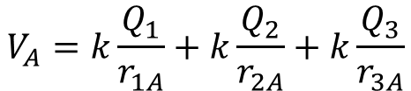
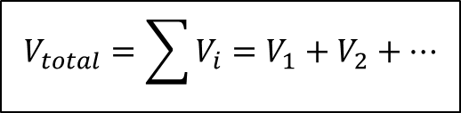






The total electric potential at a position due to multiple source charges is the sum of all the individual potentials.
$$V_{total}=\sum{V_{i}}=V_{1}+V_{2}+…$$
$$A$$
$$×$$
Include the charge sign
$$r_{1A}$$
$$Q_{1}$$
$$r_{3A}$$
$$V_{A}=k\frac{Q_{1}}{r_{1A}}+k\frac{Q_{2}}{r_{2A}}+k\frac{Q_{3}}{r_{3A}}$$
$$r_{2A}$$
$$Q_{3}$$
$$Q_{2}$$

Slide 10
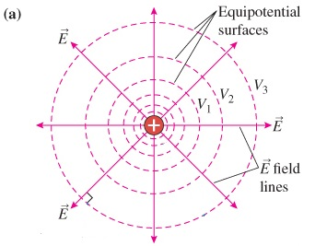
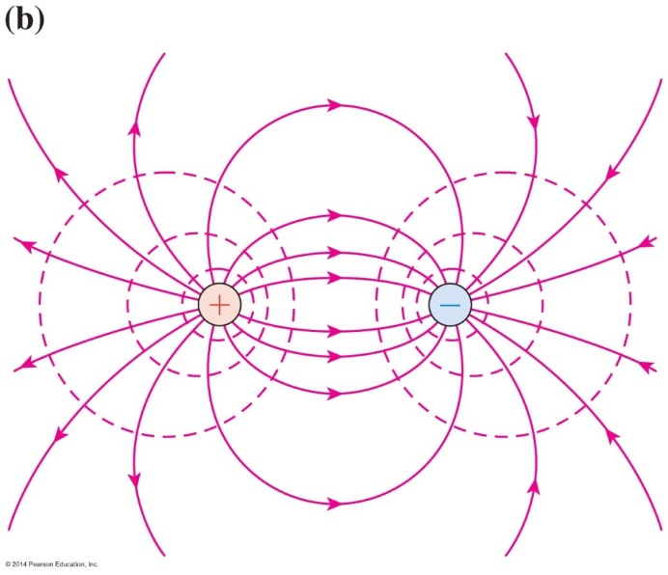


Visualize an electric potential field with equipotential surfaces, along which the electric potential is constant.
Point charge equipotential surfaces → spheres
$k\frac{Q}{r}=$ constant
Equipotentials are ALWAYS perpendicular to electric field lines
line density
implies the magnitude of electric field E, or equivalently, how fast V changes in real space.
Dipole equipotential surface
$+k\frac{\left|Q_{+}\right|}{r_{+}}−k\frac{\left|Q_{−}\right|}{r_{−}}=$ constant
Notes:
Demo 5A-35: Detection of Electric Potential

Slide 11
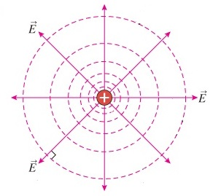





















The work done on a charge while moving in an electric field depends only on the value of the electric potential in the initial and final locations.
$$W_{inital to final}=q∆V=q\left(V_{final}−V_{initial}\right)$$
Along an equipotential surface
$$V_{A}$$
Any path between two points
$$×$$
$$W_{A to B}=q\left(V_{B}−V_{A}\right)$$
$$W_{G to H}=q\left(V_{H}−V_{G}\right)$$
$$=0$$
$$V_{B}$$
$$×$$
$$×$$
$$V_{H}$$
$$×$$
$$V_{G}$$
Path returns to the initial
equipotential surface
$$V_{C}$$
Path is closed
$$×$$
$$V_{F}$$
$$×$$
$$W_{C to D}=q\left(V_{D}−V_{C}\right)$$
$$W_{F to F}=q\left(V_{F}−V_{F}\right)$$
$$=0$$
$$×$$
$$=0$$
$$V_{D}$$

Slide 12

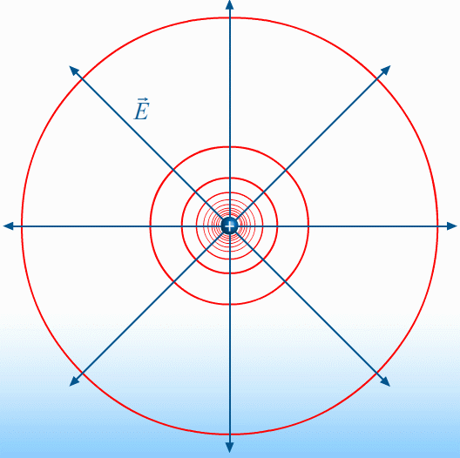
Demo

Slide 13


























The electric field points in the direction in which the electric potential decreases most rapidly.
System: Charge, Plates
Surrounding: Person
$$∆V=V_{B}−V_{A}<0$$
Charge moves from A to B at constant speed
High potential
Low potential
$$V_{A}$$
$$V_{B}$$
$$+$$
$$−$$
$$+$$
$$−$$
$$−$$
$$F_{P,x}=−qE_{x}$$
$$+$$
$${\vec{F}}_{P on q}$$
$$−$$
Work of external force from A to B
$$+$$
$$+$$
$$−$$
$$W_{A to B}=q∆V$$
$$q$$
$$+$$
$$−$$
$$+$$
$$∆x$$
$$F_{P,x} ∆x=q∆V$$
$$+$$
$$−$$
$$\left(−qE_{x}\right)∆x=q∆V$$
$$+$$
$$−$$
$$E_{x}=−\frac{∆V}{∆x}$$
Equipotential surfaces

Slide 14

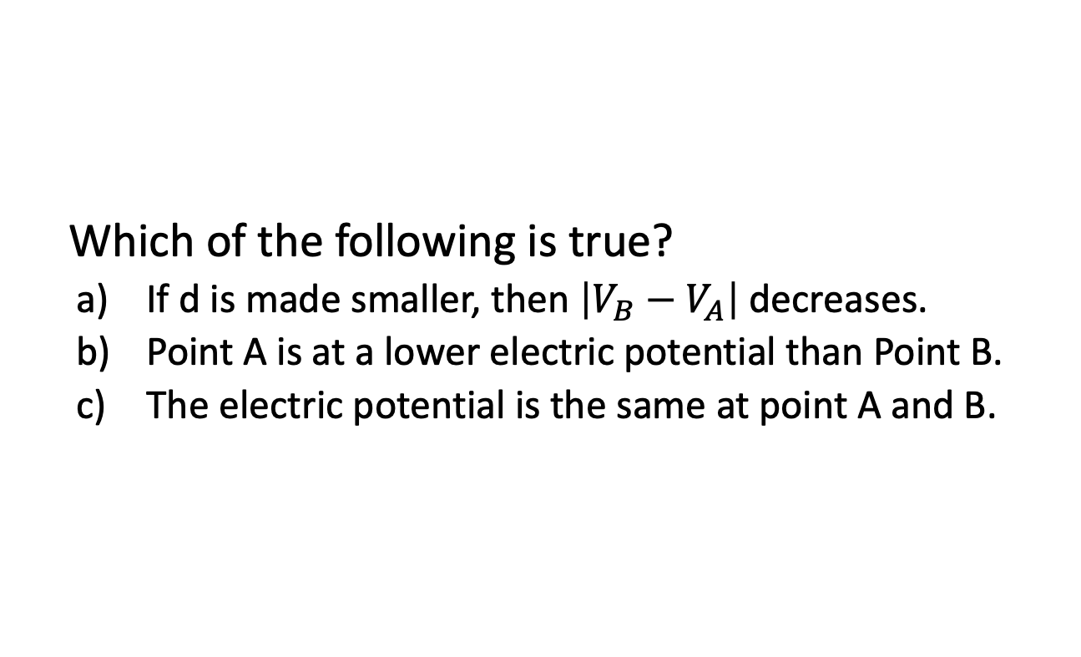



Concept Check:
Electric potential difference and electric field
Which of the following is true?
  If d is made smaller, then $\left|V_{B}−V_{A}\right|$ decreases.
  Point A is at a lower electric potential than Point B.
  The electric potential is the same at point A and B.
$$A$$
$$d$$
$$B$$
$$\left|∆V\right|=Ed$$

Slide 15
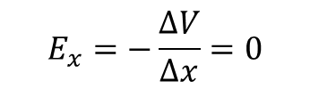








Concept Check:
Electric potential difference and electric field
In general, which is true about the electric field
and potential at a location in space?
  The electric potential can be zero when the electric field is non-zero.
  The electric potential can be non-zero when the electric field is zero.
  Both options are true.
a)
$$\vec{E}≠0$$
$$E_{x}=−\frac{∆V}{∆x}=0$$
P
b)
$$+$$
P
$$−$$
$$×$$
$$×$$
$V=+k\frac{\left|Q_{+}\right|}{r_{+}}−k\frac{\left|Q_{−}\right|}{r_{−}}=0$
P
$$V_{C}=−10V$$
$$V_{D}=−10V$$

Slide 16
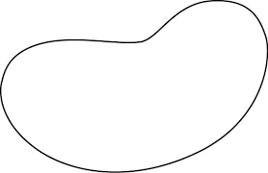




























Excess charge on a conductor in equilibrium distributes itself on the surface so that the electric field is zero and electric potential is constant inside it.
$$−$$
Charge redistributed by mutual repulsion
$$−$$
$$−$$
$$−$$
$${\vec{E}}_{net}=0$$
$$−$$
$$−$$
$$−$$
$$−$$
$$−$$
$$−$$
$$−$$
$$−$$
$$−$$
$$−$$
If $\vec{E}=0$ then $V$ is constant
Neutral conductor with a charge inside a cavity
$$+$$
$$+Q$$
Charge is drawn to cavity surface to cancel cavity field
Conductor now has an excess surface charge (inner and outer)
Surface charge redistributes according to mutual repulsion
$$+$$
$$+$$
$$−Q$$
$$−$$
$$−$$
$$−$$
$${\vec{E}}_{net}=0$$
$$+Q$$
$$+$$
$$−$$
$$−$$
$$−$$
$$+$$
$$+$$
$$+$$
Notes:
Demo 5A-13: Gauss’s Law – No Internal Field

Slide 17
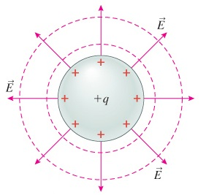
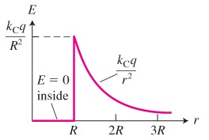
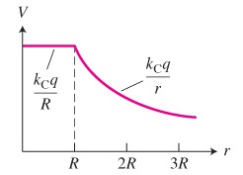
A uniform spherical charge distribution on a conductor acts like a point charge at the conductor’s center for points outside the conductor.

